Slide 1

Object Oriented Programming
Creational Design Patterns: Builder
IT560
Sourish Dasgupta
Assistant Professor, DA-IICT, Gandhinagar
https://daiict.ac.in/faculty/sourish-dasgupta

Slide 2
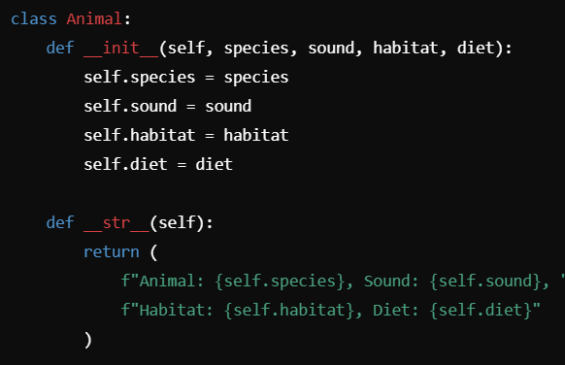
Creating Complex Objects: Building Step-by-step
IT560: Creational Design Patterns: Builder
Sourish Dasgupta

Slide 3
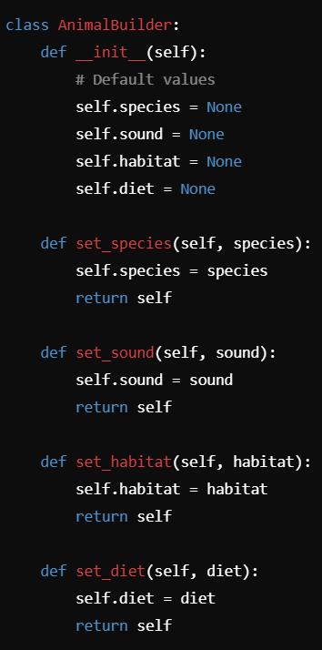
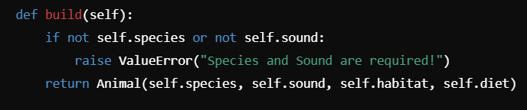
Builder Design Pattern
Builder Class (AnimalBuilder):
Handles the step-by-step construction of an Animal object.
Provides methods (set_species, set_sound, etc.) to configure the attributes of the Animal object.
Ensures defaults or constraints can be added easily (e.g., raising an error if species or sound is missing).
IT560: Creational Design Patterns: Builder
Sourish Dasgupta

Slide 4
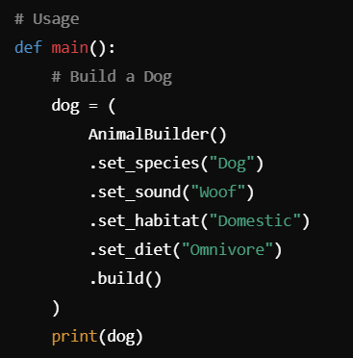

Builder Design Pattern: A detailed Dog
Chaining
IT560: Creational Design Patterns: Builder
Sourish Dasgupta

Slide 5
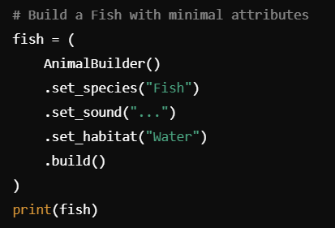
Builder Design Pattern: A minimalist Fish
IT560: Creational Design Patterns: Builder
Sourish Dasgupta

Slide 6
Why Builder Pattern?
Advantage | Explanation | Example from Code
Avoid Constructor Overload | Simplifies object creation without requiring multiple constructors for different attribute combinations. | Instead of multiple Animal constructors (e.g., with/without habitat, diet, etc.), AnimalBuilder provides a step-by-step interface.
Readable Object Creation | Object construction is easier to read and understand with named methods for setting attributes. | AnimalBuilder().set_species("Dog").set_sound("Woof").build() is more readable than Animal("Dog", "Woof", "Domestic", "Omnivore").
Scalability | New attributes can be added easily without modifying the existing class or constructor logic. | Adding a set_lifespan() method in AnimalBuilder doesn’t affect existing Animal code.
IT560: Creational Design Patterns: Builder
Sourish Dasgupta

Slide 7
Why Builder Pattern?
Validation | Ensures required fields are set and invalid configurations are avoided before object creation. | The build() method raises an error if species or sound is missing.
Flexible Configuration | Allows objects to be constructed with varying levels of detail, from minimal to fully detailed. | Example: A minimal Fish with only species and sound, or a full Dog with habitat and diet.
Fluent Interface | Enables chaining of method calls for concise and expressive code. | AnimalBuilder().set_species("Dog").set_sound("Woof").build() uses method chaining for clarity.
Improved Maintainability | Separates object creation logic from the class itself, making the code easier to manage and extend. | AnimalBuilder encapsulates the logic for setting attributes, keeping Animal clean and focused.
IT560: Creational Design Patterns: Builder
Sourish Dasgupta

